Slide 1

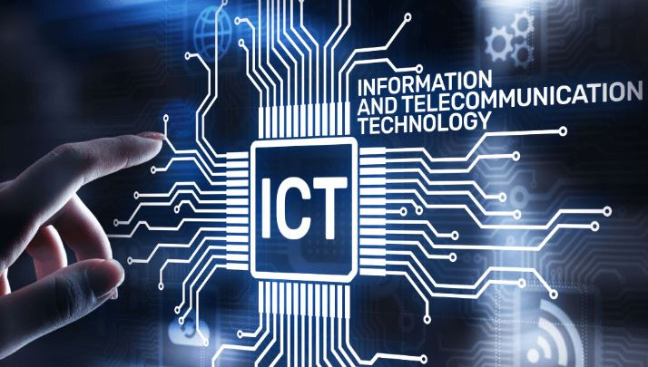
INFORMATION
AND COMMUNICATION TECHNOLOGY

Slide 2

Hamza Riadh HATTAB
Meet our Team
TEAM 46
Sidehmed GUERZA
Tarek AZZOUZ BENAZIZA
Mohamed Amine BAZIZ
Abdlatif AICHAOUI

Slide 7

4

Slide 8
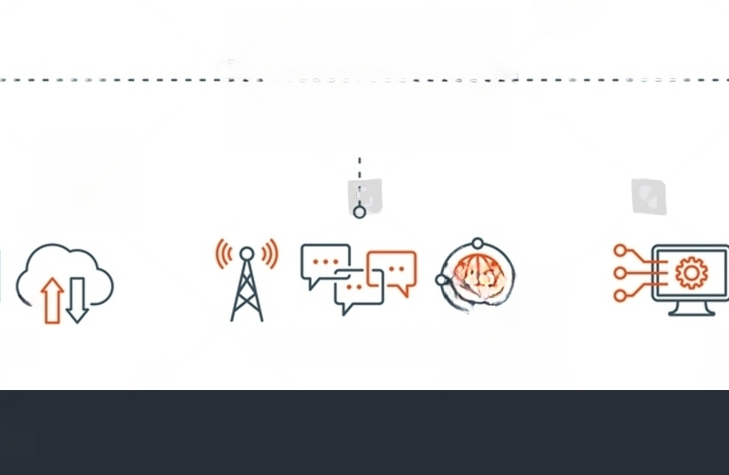
ICT
DEFINITION
Information and Communication Technology (ICT) is an all-encompassing term referring to the infrastructure and components that enable modern computing. It includes communication devices, telecommunication tools, and support services, serving as the backbone of contemporary technological advancements.
.
INFORMATION
COMMUNICATION
TECHNOLOGY
5

Slide 9



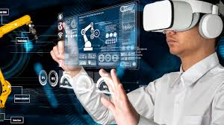
Importance of ICT
Connectivity
ICT is the backbone of interconnectivity and enables seamless communication among devices, systems, and people.
Big Data Analytics
With the help of ICT, we can collect, analyze, and make sense of massive amounts of structured and unstructured data.
Augmented Reality
Artificial Intelligence
ICT has enabled the development of AI algorithms and systems that can learn, reason, and make predictions.
ICT has made it possible to superimpose digital information on the physical world, potentially transforming how we interact with our surroundings.
6

Slide 10
7

Slide 11




Overview of Google Services
Google Classroom
Gmail
Google Drive
Google Meet
Email service provider with a search-oriented interface, powerful spam filtering, and integrated chat features.
A cloud-based storage solution with inbuilt editor tools for creating presentations, spreadsheets and documents.
Video conferencing tool with integrated scheduling and screen sharing features.
A platform for teachers and students to access a streamlined set of communication and collaboration tools like coursework assignment, group discussion, and grade tracking.
8

Slide 12
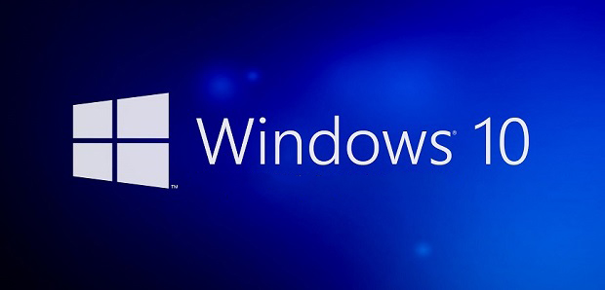
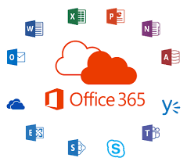

Overview of Microsoft Tools
Windows 10
Office 365
Azure
Desktop operating system with a user-friendly interface, built-in security features, and cloud integration capabilities. Compatible with most desktop applications.
A suite of productivity tools including Word, Excel, and PowerPoint, enhancing collaboration and document creation.
A cloud computing service used for building, testing, deploying, and managing applications and services through a global network of Microsoft-managed data centers.
9

Slide 13



Introduction to Git and GitHub
Git
A distributed version control system that helps software development teams track changes in code and collaborate more efficiently.
GitHub
A web-based hosting service for git repositories that provides tools for managing projects, code review, and continuous integration. Also, a community where developers can discover, contribute to and discuss projects.
10

Slide 14
Examples of Using ICT Technologies
Healthcare
ICT has enabled the healthcare industry to improve the efficiency and efficacy of medical treatment and research. The incorporation of technology has helped to solve a number of challenges and inefficiencies the industry faces.Electronic medical record systems help improve the accuracy of patient records and enable remote access to healthcare informationTelemedicine allows doctors to attend to patients remotely via the internet, improving the accessibility of healthcare services to people in remote locations
Education
Technology has revolutionized the process of teaching and learning, making it more interactive, engaging, and convenient. New technologies have enhanced the flexibility and opportunity for learning.E-Learning management systems provide personalized learning experiences, including online courses, tutorials, and digital text books Virtual reality and augmented reality technologies enable students to simulate scenarios and engage in interactive activities that enhance understanding and retention of information
E-commerce
Online shopping is driven by hardware and software advancements, which have revolutionized the way companies market and distribute products, interact with customers and gather feedback.Retailers use e-commerce websites to promote and sell products, manage orders, and handle customer support requestsSmart and secured payment solutions enable online transactions without the need of customers visiting physical outlets
11

Slide 15
12

Slide 16

Conclusion
Information and Communication Technology is constantly evolving, reshaping industries, empowering individuals, and creating new opportunities. Embracing ICT is crucial for staying competitive in the digital age.
Key Takeaways
ICT enhances connectivity, efficiency, and learning.
Google Services and Microsoft Tools offer powerful solutions.
Git and GitHub improve collaboration and version control.
The future of ICT lies in AI, IoT, and cybersecurity.
The Future of ICT
Artificial Intelligence and Machine Learning
ICT advancements are driving the development of AI and ML, transforming industries and enhancing decision-making processes.
Internet of Things (IoT)
ICT integration with physical objects is revolutionizing smart homes, cities, transportation, and healthcare.
Cybersecurity Challenges
As technology evolves, ensuring robust security measures is critical in safeguarding sensitive data and systems.
13

Slide 17
QUOTE
“Technology is a compulsive and addictive way to live. Verbal communication cannot be lost because of a lack of skill. The ability to listen and learn is key to understanding, and effective communication is essential in the age of Information and Communication Technology .”
-Unknown-

Slide 18
Dear Redouane Bouchekir
We want to extend our sincere gratitude for your attentive reading of the PowerPoint presentation. Your commitment to understanding the content and your thoughtful consideration are truly appreciated. Thank you for investing your time in exploring the information presented. Your engagement contributes significantly to the success of the presentation.
Best Regards
TEAM 46

